Slide 1
FRONTIER / 2026
AGENTIC SYSTEMS TRACK
— TRACK 03 · AUTONOMY & TOOLS
AGENTIC SYSTEMS PRESENTATION
— OPENING NOTE
“Most AI applications answer a prompt. Agentic systems go further—they understand a goal, decide the next step, use tools, and complete a useful workflow.”
AGENTIC
SYSTEMS.
EVENT
TRACK HEAD
FRONTIER 2026 — AGENTIC SYSTEMS TRACK
YOUR NAME
01 / 09
Building AI that can reason, use tools & take action.

Slide 2
FRONTIER / 2026
AGENTIC SYSTEMS TRACK
02
DEFINITION & CAPABILITIES
— TRACK BRIEFING
WHAT MAKES A
SYSTEM AGENTIC.
— DEFINITION
— CAPABILITIES
Agentic AI is AI that works toward a goal through multiple steps.
01
Understand a user's goal
02
Decide the next best step
03
Use tools, APIs, databases, or search
— PROCESS FLOW
UNDERSTAND
04
Observe results and adapt
→
DECIDE
→
ACT
→
EVALUATE
05
Ask for approval when an action is sensitive
Autonomy does not mean unlimited control. Good agents work with permissions, guardrails, and human approval.
FRONTIER 2026 · AGENTIC SYSTEMS
PAGE 02 / 09

Slide 3
FRONTIER / 2026
AGENTIC SYSTEMS TRACK
03
WORKFLOW & BUILDING BLOCKS
— TRACK BRIEFING
HOW DOES AN
AI AGENT WORK.
— CORE BUILDING BLOCKS
LLM + INSTRUCTIONS
TOOLS & APIs
MEMORY / STATE
Foundation reasoning with a clear system prompt.
External capabilities the agent can invoke.
Context carried across steps or sessions.
PLANNING LOGIC
EVAL & ERRORS
GUARDRAILS
Deciding what to do next given the goal.
Checking results, retrying, or asking for help.
Permissions and human approval on sensitive actions.
— AGENT WORKFLOW
01
02
03
04
05
06
USER GOAL
PLAN NEXT STEP
CHOOSE TOOL
TAKE ACTION
OBSERVE RESULT
EVALUATE
— ITERATIVE · HUMAN-IN-THE-LOOP
Continue · Retry · Ask for Approval — the loop repeats until the goal is met safely.
FRONTIER 2026 · AGENTIC SYSTEMS
PAGE 03 / 09

Slide 4
FRONTIER / 2026
AGENTIC SYSTEMS TRACK
04
COMPARISON
— TRACK BRIEFING
CHATBOT VS
AI AGENT.
CHATBOT
AI AGENT
Responds to a prompt
Works toward a goal
Usually gives one answer
Performs multiple steps
User guides every step
Decides the next step
Mainly generates content
Uses tools and APIs
Limited context
Can use memory / state
— EXAMPLE
— IMPORTANT
Chatbot suggests a travel itinerary. An AI agent compares options, checks weather and budget, drafts an itinerary, then asks before booking anything.
High-impact actions—payments, bookings, sending emails—must require user confirmation.
FRONTIER 2026 · AGENTIC SYSTEMS
PAGE 04 / 09

Slide 5
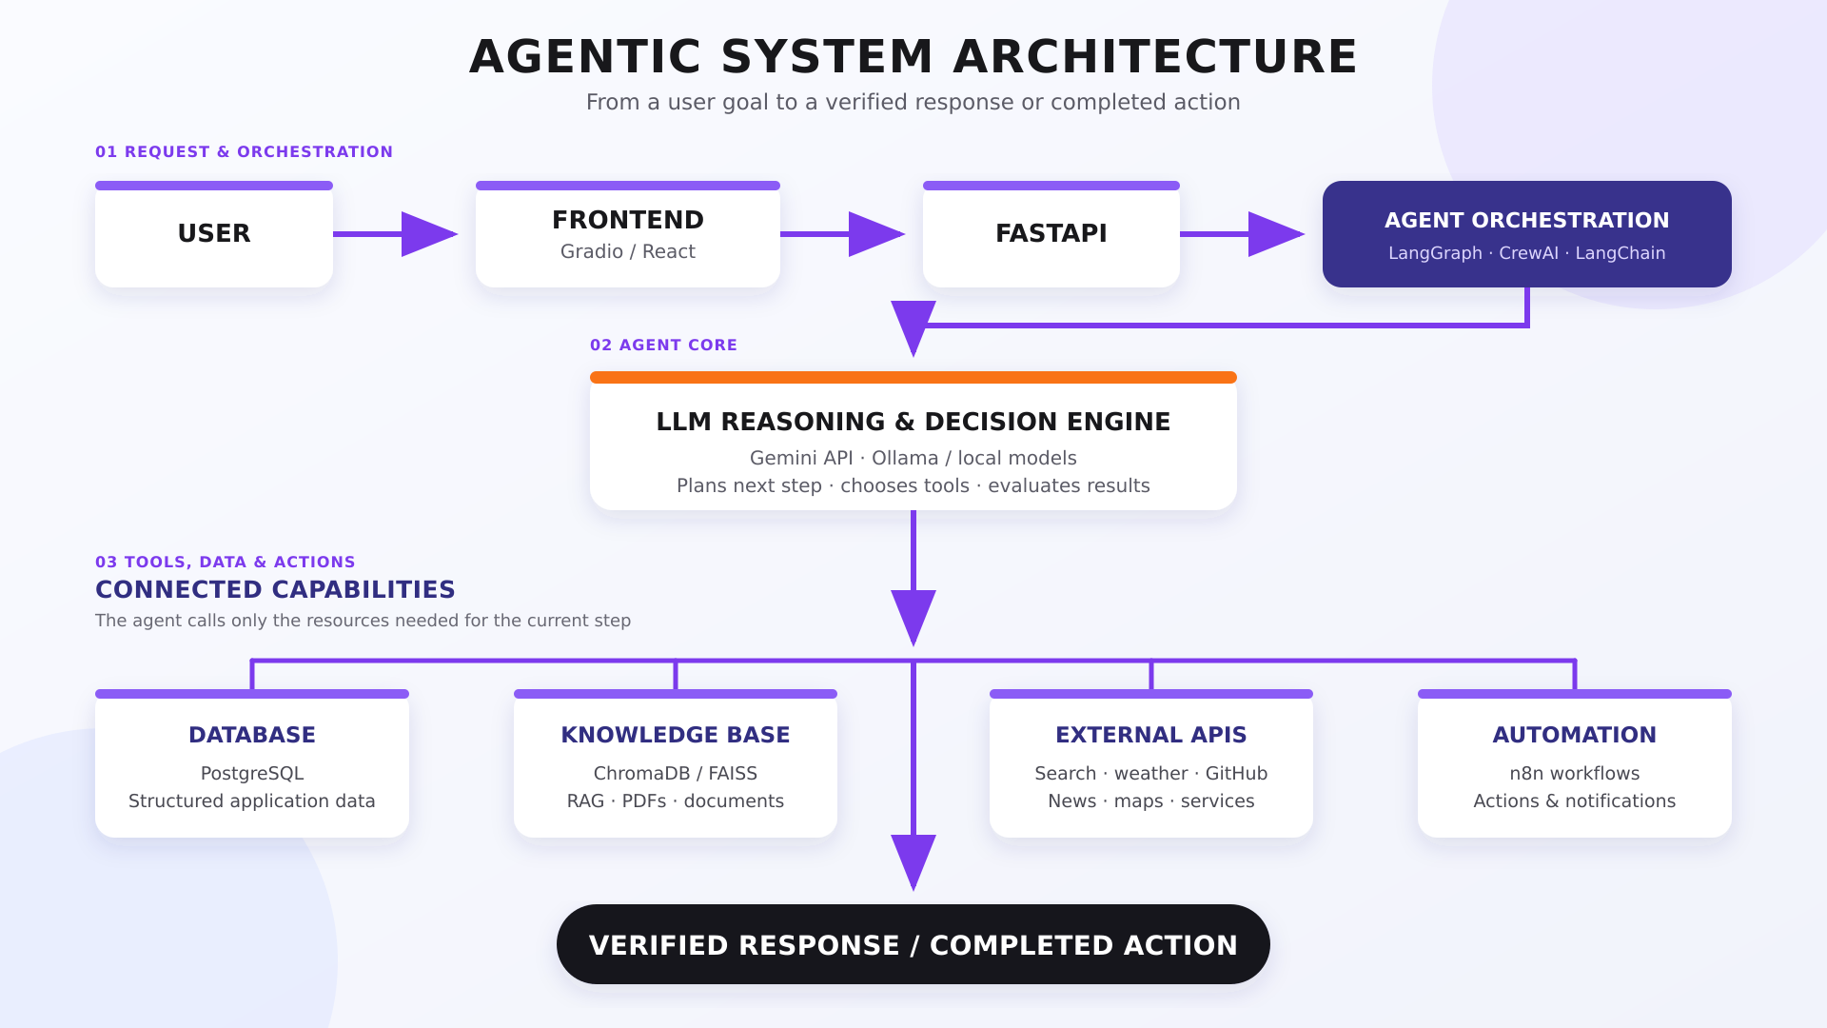

Slide 6
FRONTIER / 2026
AGENTIC SYSTEMS TRACK
05
CASE STUDY
— TRACK BRIEFING
A REAL AGENTIC
WORKFLOW.
— RESEARCH & EVENT PLANNING AGENT
— APPLICATION AREAS
01
Receives a topic and requirements
EDUCATION
02
Searches reliable sources
CUSTOMER SUPPORT
03
Extracts and compares information
CODING
04
Saves findings with citations
PRODUCTIVITY
Creates a structured event plan
HEALTHCARE ADMIN
05
FINANCE TRACKING
06
Checks whether all requirements are covered
07
Requests approval before publishing
Agentic systems automate workflows—not only conversations.
FRONTIER 2026 · AGENTIC SYSTEMS
PAGE 05 / 09

Slide 7
FRONTIER / 2026
AGENTIC SYSTEMS TRACK
06
TOOLING
— TRACK BRIEFING
FREE APIS, MODELS
& FRAMEWORKS.
— MODEL APIs (FREE / FREE-TIER)
— AGENT FRAMEWORKS
GEMINI API
LANGGRAPH
Text, image, document & multimodal — free tier.
Stateful workflows — retries, memory, approvals.
GROQ API
LANGCHAIN
Very fast inference for open models.
Tool calling, RAG, integrations, prototyping.
CREWAI
OLLAMA
Role-based multi-agent workflows.
Run open-source models locally—no API cost.
AUTOGEN
HUGGING FACE
Conversational multi-agent systems.
Open models, datasets, demos, inference.
OPENAI AGENTS SDK
OPENROUTER
Agents, tools, handoffs, sessions, tracing.
PYDANTICAI
“Free” often means open-source or free-tier — verify quota, rate limits, and event-day availability before you build.
One API, many models—limited free access.
Structured, typed Python agent applications.
FRONTIER 2026 · AGENTIC SYSTEMS
PAGE 06 / 09

Slide 8
FRONTIER / 2026
AGENTIC SYSTEMS TRACK
07
RECOMMENDED STACK
— TRACK BRIEFING
SUGGESTED
STARTER STACK.
01
02
MODEL
AGENT FRAMEWORK
Gemini API · Groq · Ollama
LangGraph · CrewAI
03
04
BACKEND
KNOWLEDGE BASE
FastAPI · Flask · Node.js
ChromaDB · FAISS
05
06
DATABASE
TOOLS
PostgreSQL · MongoDB · Firebase
Search · Weather · Maps · Calendar · Email
07
08
AUTOMATION
DEPLOYMENT
n8n
Docker + Render / Railway / Cloud
— RECOMMENDED FOR BEGINNERS
FRONTIER 2026 · AGENTIC SYSTEMS
PAGE 07 / 09
Gemini or Groq + LangGraph + FastAPI + ChromaDB + a simple React UI.

Slide 9
FRONTIER / 2026
AGENTIC SYSTEMS TRACK
08
BRIEF FOR PARTICIPANTS
— TRACK BRIEFING
WHAT SHOULD
YOU BUILD.
— MUST HAVE
— STRONG ADDITIONS
01
A real, specific problem statement
+
RAG with cited sources
02
A clearly defined user goal
+
Persistent memory
03
A multi-step agent workflow
+
Human approval before sensitive actions
04
At least one meaningful external tool or API
+
Agent logs, tracing, or evaluation
05
Tool-result checking
+
Multi-agent design only when roles differ
06
Error handling or retry logic
— TEST YOUR PROJECT
07
A working end-to-end demo
If the system only takes one prompt and gives one answer, it is likely a chatbot—not an agentic system.
FRONTIER 2026 · AGENTIC SYSTEMS
PAGE 08 / 09

Slide 10
FRONTIER / 2026
AGENTIC SYSTEMS TRACK
09
— JUDGING · TIPS · CLOSING
BUILD THE
WORKFLOW.
— WHAT WE LOOK FOR
— WINNING TIPS
· Useful problem statement
· Build small, but reliable
· Clear agent design & workflow
· Demo the full workflow live
· Meaningful tool integration
· Show why each tool is necessary
· Context or memory where needed
· Handle errors gracefully
· Multi-step automation
· Keep the UI simple, focus on backend
· Reliable execution & error handling
· No multi-agent buzzwords
· Good user experience
· Scalability & modularity
Think beyond the response. Build the workflow.
Can your system understand a goal, choose actions, use tools, evaluate results, and handle failure safely? — Questions welcome.
09 / 09

